Slide 1
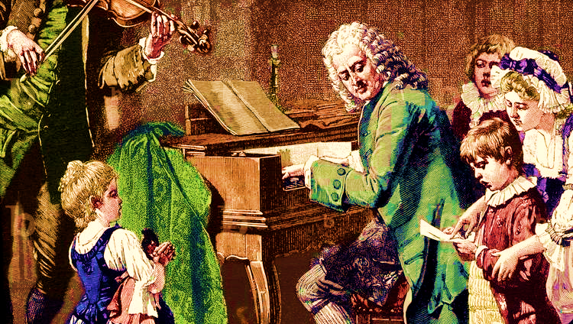
TWO GIANTS OF BAROQUE: HANDEL & BACH
Arthur Gabriel 12110934
王谦益 12111003

Slide 2
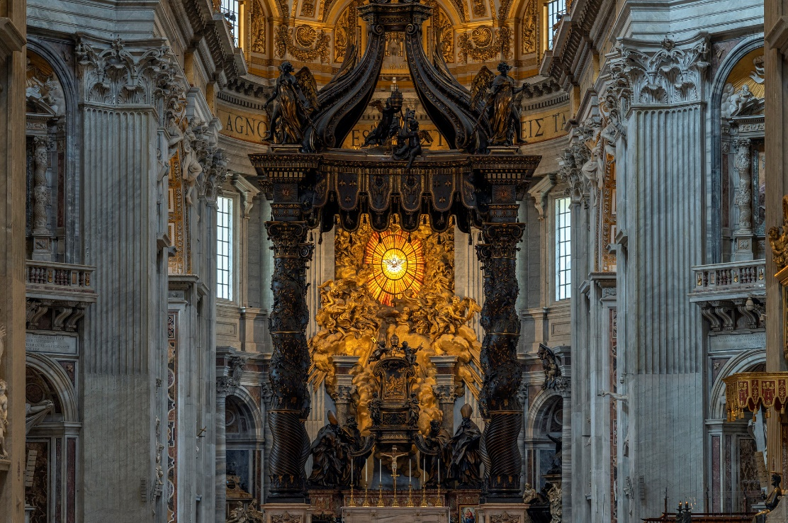
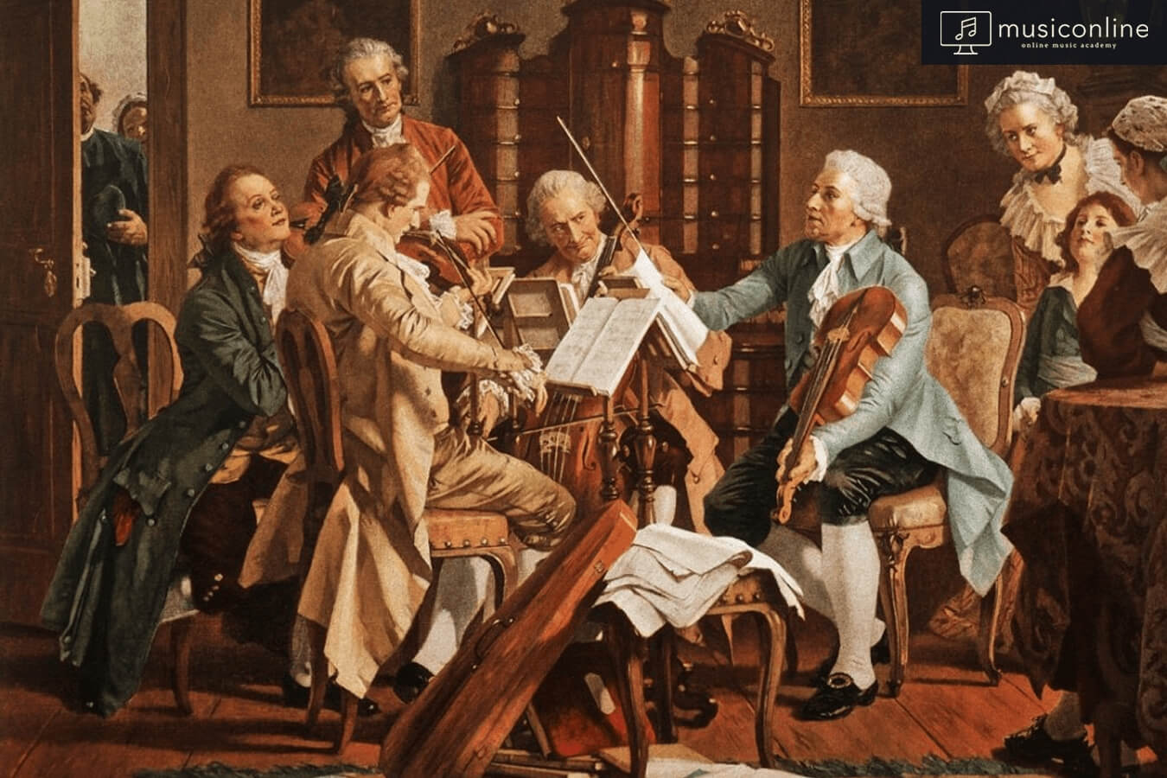
Baroque Period
1600 to 1750
= Irregular pearl
Key aspects:
Following Renaissance
Non-sacred instrumental music ↑
Italian musical trends
Experimentation and innovation on music

Slide 3
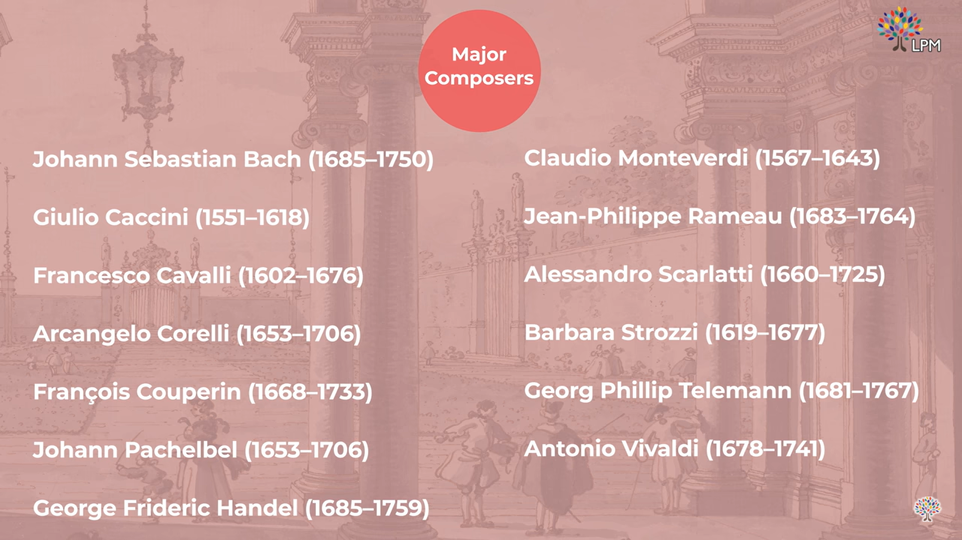

Slide 5
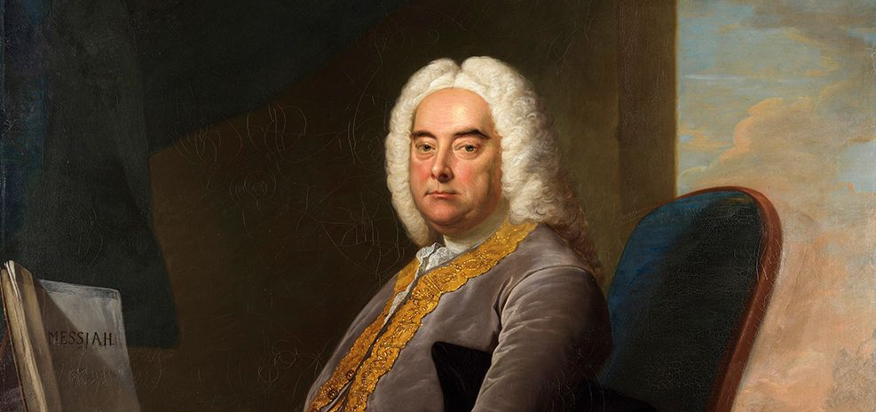
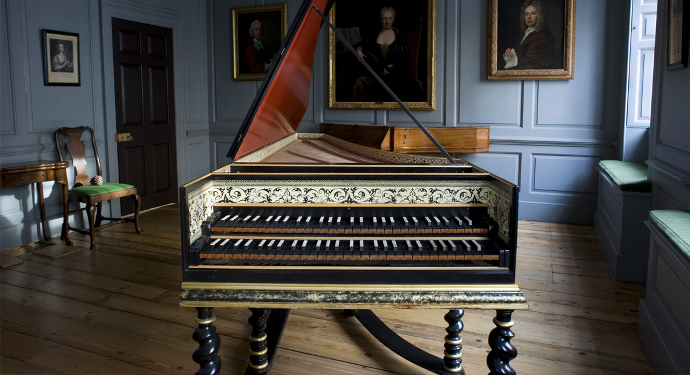
George Frideric Handel: Major Timeline
Childhood in Halle, Saxony: private exploration of organ and harpsichord
Skilled in violin, organ, and harpsichord
In Italy: exposed to Italian opera, oratories
In London: operas → oratories
Water Music (1717)
Zadok the Priest (1727)
Messiah (1741)

Slide 6
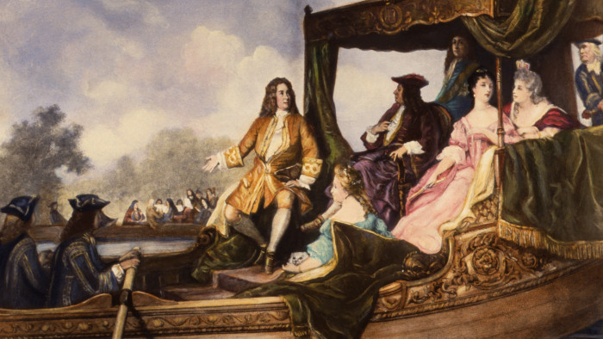
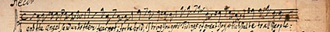
George Frideric Handel: His Style
Dramatic expression → emotions!
Choral writing → deeper meaning
Melodic invention → unique
Harmonic language → sophisticated
Ornamentation, Basso Continuo
~ English New Opera (ENO)

Slide 7

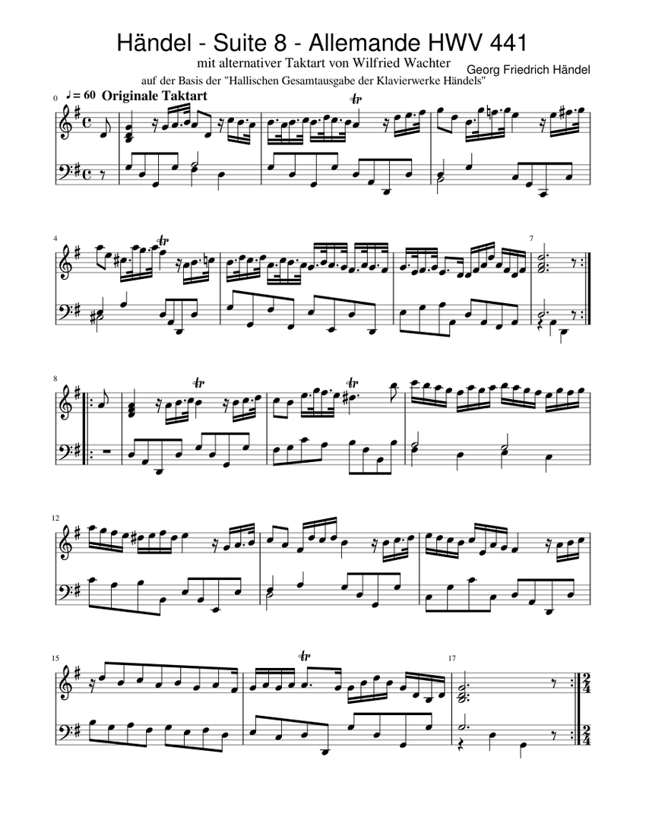
George Frideric Handel: Harpsichord
25 suites for harpsichord:
Eight Great Suites (“1720”)
The Second Collection (“1733”)
Not as popular as Bach’s because:
Overshadowed by Bach
Overshadowed by Handel’s own operas and oratories
Suite No. 8 in G Major, HWV 441
I. Allemende

Slide 8
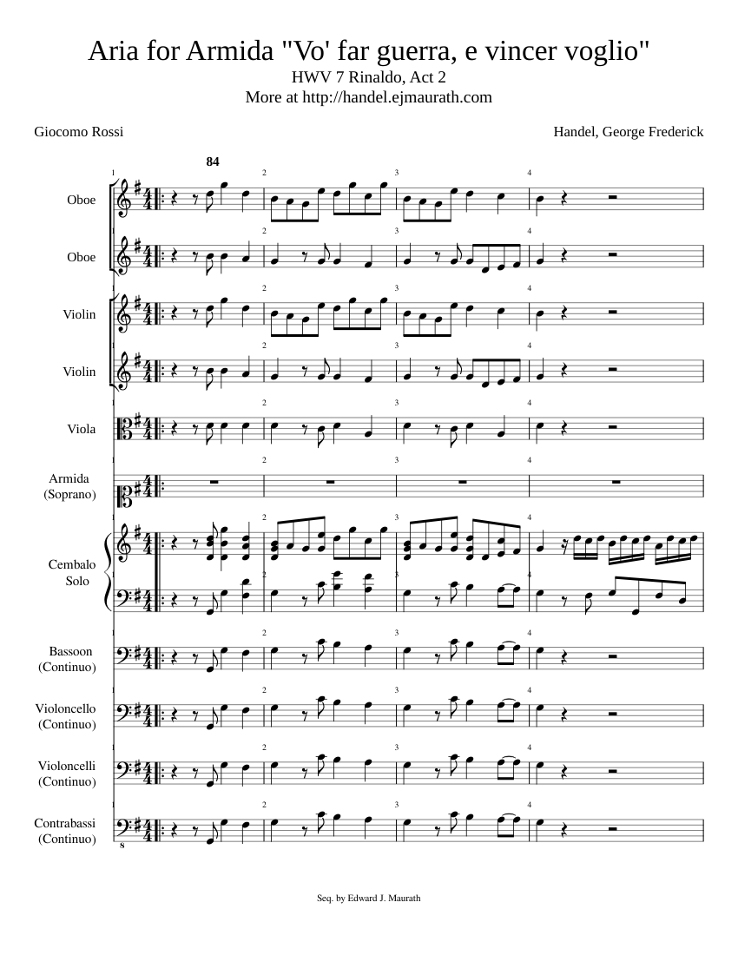
Vo´ far guerra from Rinaldo

Slide 9
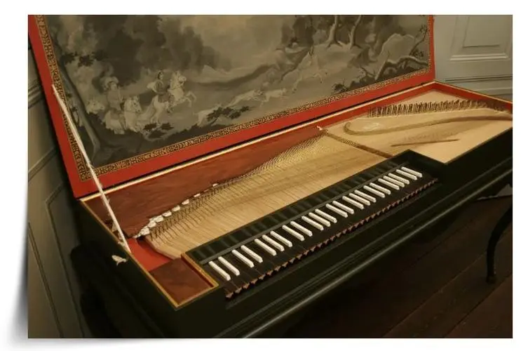
Johann Sebastian Bach: Major Timeline
1700: went to Luneburg, studied in the choir
1703-1707: served in Arnstadt and Muhlhausen
1708: became organist of the Court Church in Weimar
1717: served as court musician and keyboardist at Prince Leopold's residence
1723: went to Leipzig, where he worked as choral conductor and Music director of the Church of St. Thomas
Skilled in organ, clavichord and orchestration

Slide 10
Johann Sebastian Bach: His Style
Fugue as the Primary Genre → the most prominent feature
Complex Harmonic Structure → he is adept at using different chord progressions
Clear Structure and Logic → tight organization and form
Application of Counterpoint → order and harmony in the music
Modulation Techniques → intersperses melodies and harmonies in different modes
Religiosity → religious themes and connotations
Technical Proficiency → challenging finger techniques and harmonic treatments

Slide 11
Johann Sebastian Bach: clavichord
For own virtuosity:
Toccata and Fugue in D minor,BWV 565
Chromatic Fantasia and Fugue in D minor BWV903
Suites:
French Suite
English Suite
Partita
For teaching purposes:
Invention
The Well-Tempered Clavier

Slide 12
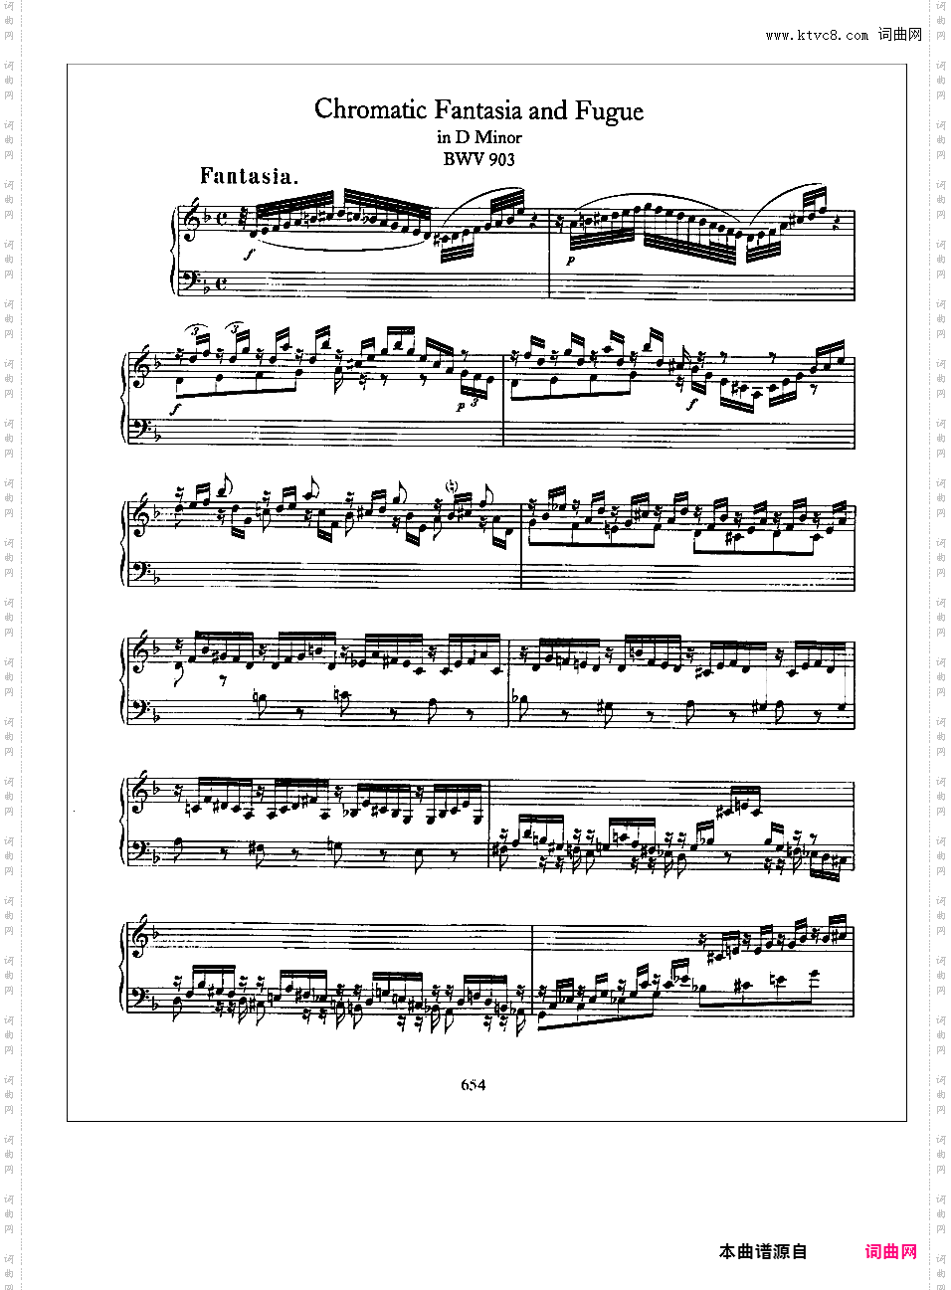
Chromatic Fantasia and Fugue
in D minor

Slide 13
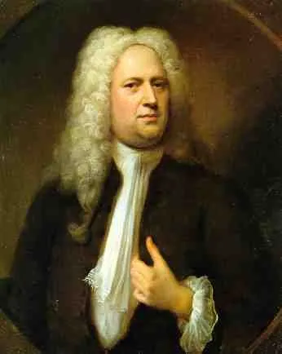
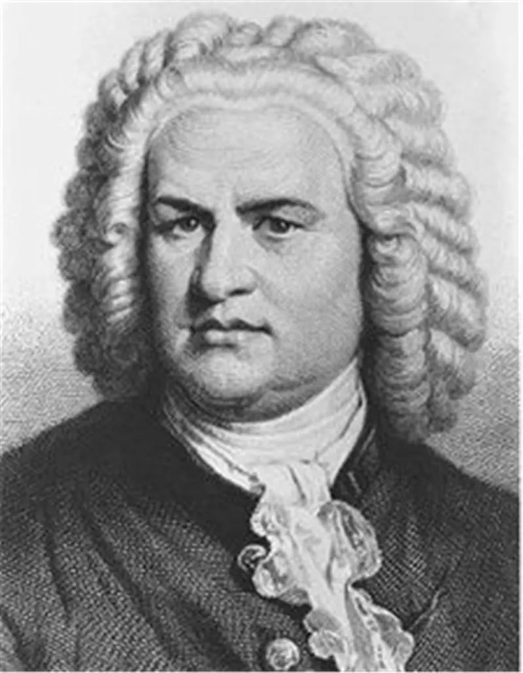

Slide 14
Thank you

